Slide 1
Optimizing organ matching markets
EIN 5501/4905
Venkata Praveen Naradasu,Minsung Kang,Sneha Dasgupta,Prathyush Reddy
Department of Industrial and Systems Engineering

Slide 2
Today’s Agenda
Introduction and Problem Statement
Who is Altruist and their importance
Mathematical model
Results
Discussion

Slide 3
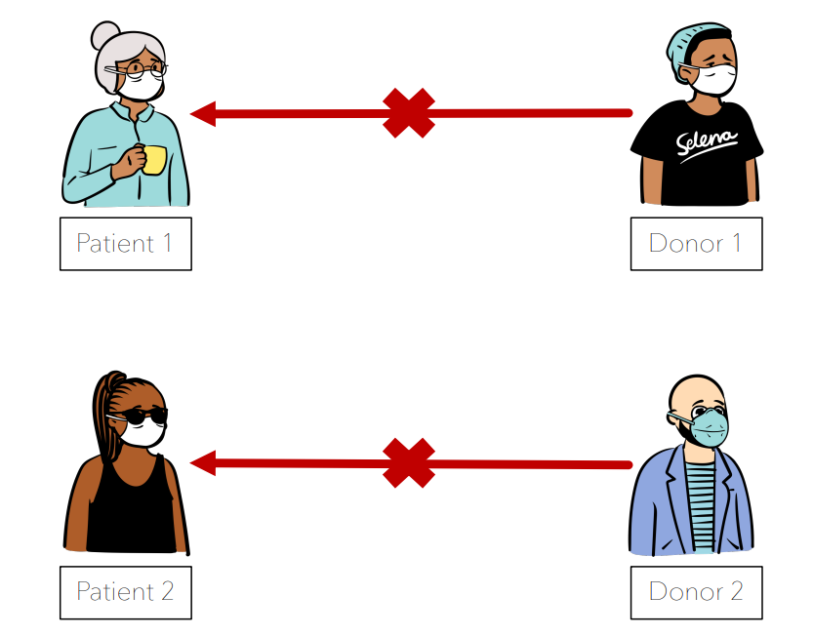
One of many simple constraints: A husband can’t donate a kidney to his wife if she has antibodies produced by her exposure in childbirth to the proteins their newborn inherited from him.
Notes:
For simplicity, we are using Kidney transplantation as example although our mathematical model can be generalized to any such market.

Slide 4
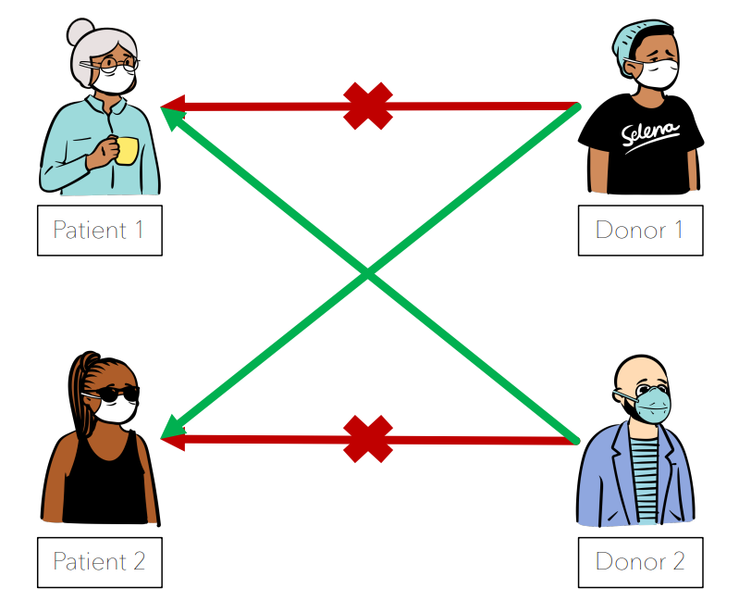

Slide 5
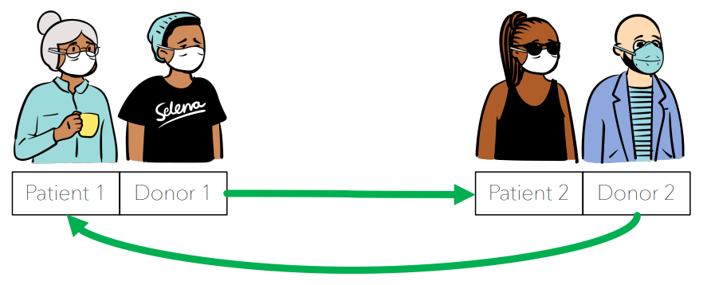

Slide 6
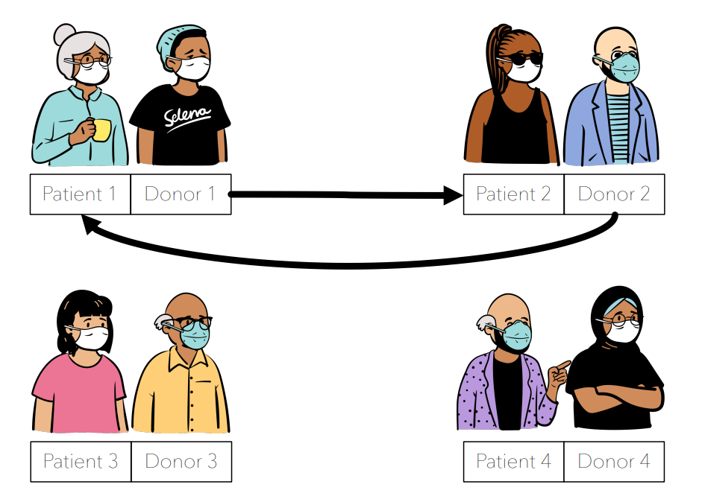

Slide 7
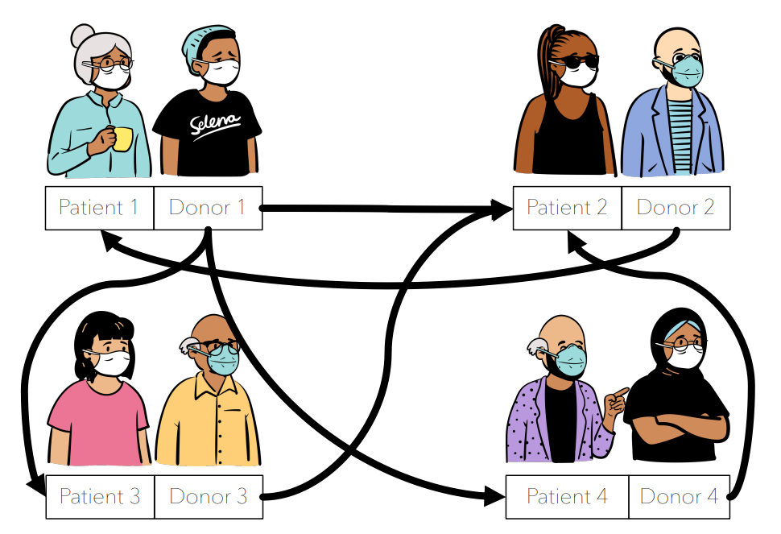

Slide 8
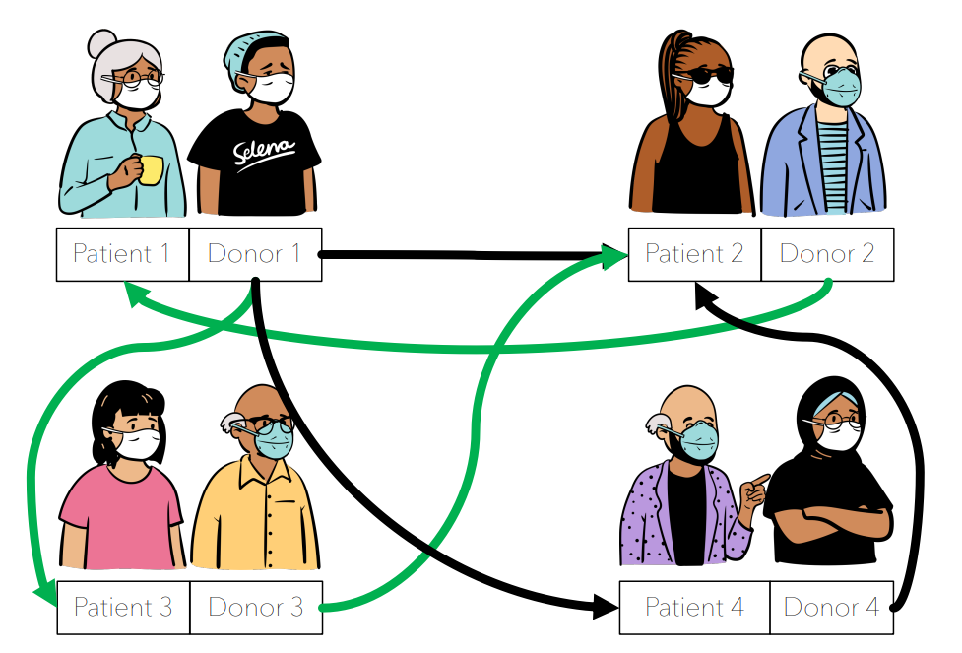

Slide 10
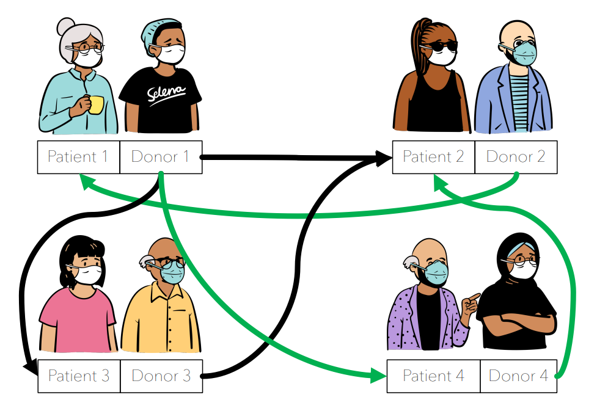

Slide 11
Problem Statement:
Every year several thousand patients die waiting for a transplant.As we understand how important it is to maximize the successful transplants in a pool of (Donor,Patient) pairs, the success entirely relies on maintaining thickness of the markets
Once thickness is achieved,its a matter of mathematical optimization for maximizing successful matches.
Notes:
More than 70,000 patients in the United States are waiting for a kidney transplant from a deceased donor, but because of a shortage of suitable donors and, sometimes, the difficulty of getting a kidney to a suitable patient while it is still viable, fewer than 11,000 a year receive such transplants. Every year several thousand patients die waiting for a transplant. But because people are born with two kidneys and can remain healthy with only one, a person can donate a kidney to a friend or loved one. More than 6,000 live-donor transplants are performed each year.

Slide 12
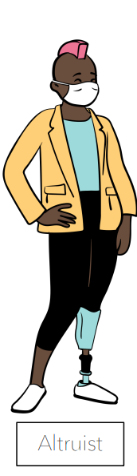
Altruist:
showing a disinterested and selfless concern for the well-being of others; unselfish.

Slide 13
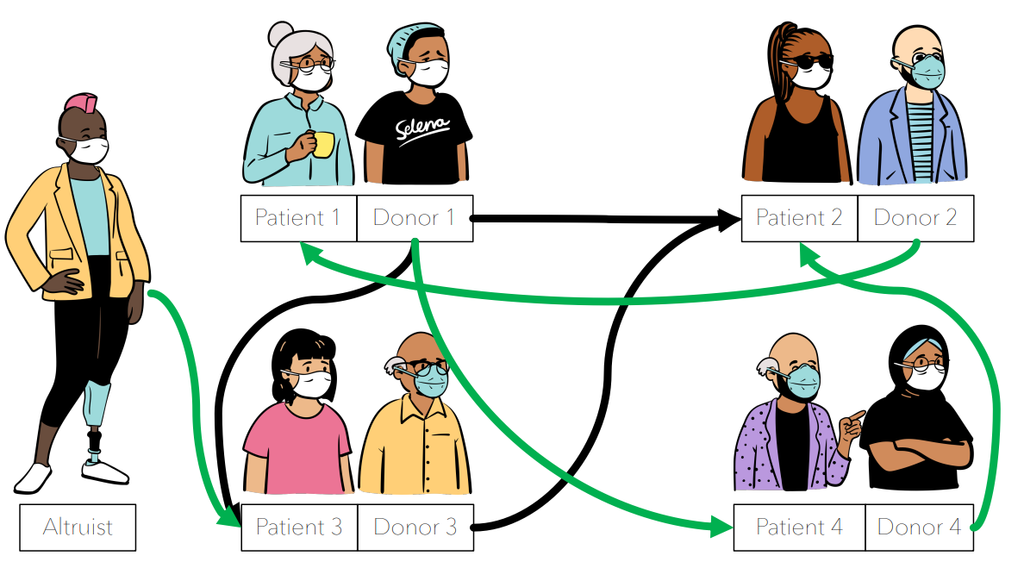

Slide 14
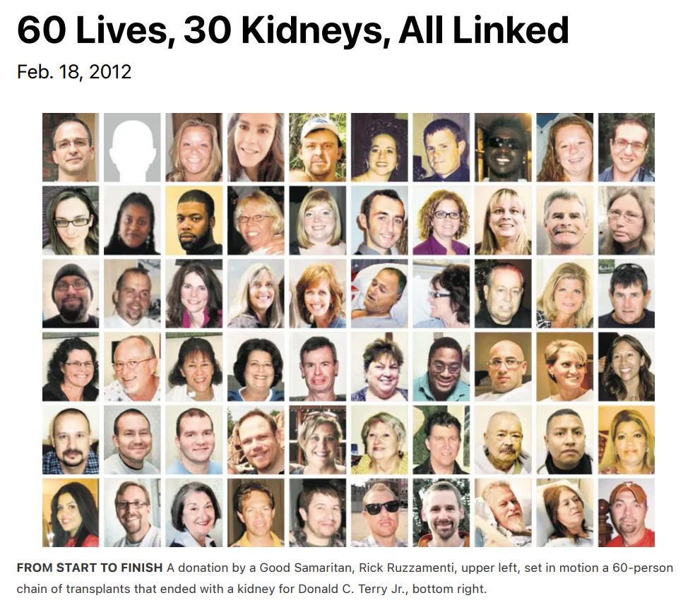
Importance of Altruist:
Notes:
An altruistic donor is a person that wishes to donate a kidney but who has no intended recipients; they simply want to donate to someone who can benefit from a transplant. Other terms used to describe altruistic donors include "non-directed" or "Good Samaritan" donors. Altruistic donors are a huge part of the success of Kidney Paired Donation transplants because they add a donor but not a recipient into a registry, thereby increasing the donor pool.
Many Kidney Paired Donation transplant chains start with an altruistic donor, and after the first round of transplants, the incompatible family member or friend of one of the recipients of the first round of transplants then acts as the bridge donor that initiates the next set of transplants (graphic below shows how an altruistic donor kicked off a chain of transplants, which left a bridge donor to initiate another chain of transplants).Alternatively, the remaining donor may also donate to someone waiting on the deceased donor list, and the chain ends at that time. By kicking off donor chains such as the one above, an altruistic donor has the opportunity to help numerous patients, since without the altruistic donor, the patient may not have received a transplant.

Slide 15
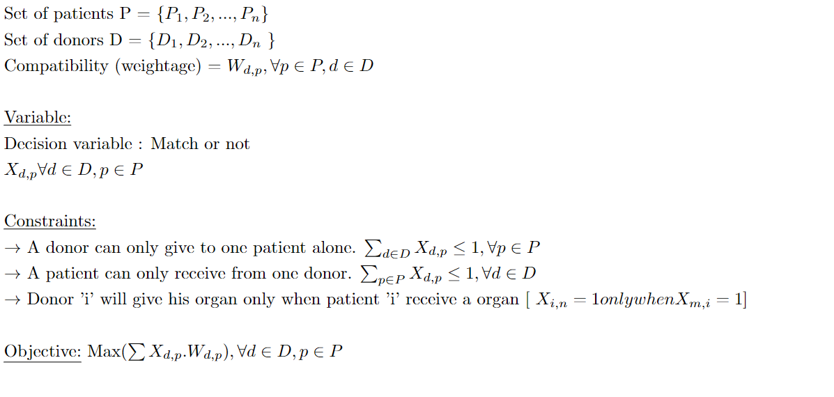
Mathematical Model:

Slide 16
Data:
Synthetic Data of 200 patient,donor pairs + 10 Altruists
Assumed a possible match from each donor to be a maximum of 3.
Match percentage is a random number between 1-100.
Tools:
Python,Gurobipy for optimization
Result: 147 Successful matches. (Varies as input is random)

Slide 17
Current findings & Future scope :
We concentrated on drawing results for the first two constraints in this project.
We primarily concerned with getting the best possible match and compatibility.
We focused to finalize our function and draw the result.
We will compare how result changes as we change hyperparameters.

Slide 18
THANK YOU
We would love to hear your questions and feedback!
CREDITS: New York Times 2012,2015 articles on Kidney Transplant chains
Image source:openpeeps.com
From Prof. Aleksandr M. Kazachkov’s class of ‘DA for Social Good’

